Slide 1

Facial recognition & classification using CNNs
VITZILAIOS VASILEIOS
MTN2201

Slide 2
Contents
Introduction
Data Collection and Preparation
Model Architecture
Training & Evaluation
Real-Time Inference
Difficulties & Obstacles
Conclusions and Future Work
Questions and Discussions

Slide 3
Introduction
Facial recognition AI application using Convolutional Neural Networks (CNNs).
Accurately recognize and classify faces in real-time.
Data preparation from live camera feed, designing and training multiple CNN models, implementing real-time inference capabilities.
Success is measured by evaluation metrics such as accuracy, precision, recall, and F1 score.
Future work: refining the system, exploring its potential application.

Slide 4
Data collection & preparation
Dataset created by using the “add face” feature of the app.
Also contained parts of LFW (Labelled-Faces-In the Wild) dataset.
Combining datasets was a sufficient help to quickly dip into training process.

Slide 5
Data collection & preparation
To prepare our data for the CNN model, we applied several pre-processing steps.
Resized and normalised the images to ensure more effective predictions.
Increase diversity and volume of our training data, using data augmentation techniques. This helps the models to generalize better to new data.
Random rotation, flipping, etc.

Slide 6
Model architecture
Designed for adaptability and ease of use.
Multi-Model Design: Can handle multiple CNNs, enhancing flexibility and efficiency.
Flexible Parameterization: By parametrizing the scripts, the app can be handled effectively to train, load or calculate metrics.
Easy Model Comparison: This feature allows for easy testing, comparison, and deployment of different models.

Slide 7
Model 2
Design Philosophy: Combination of CNN layers and FC Layers.
Layers Overview:
Convolutional Layers: Three convolutional layers extract spatial features from the input images. The first layer has 64 filters, the second layer 128, and the third 256 all employing a 3x3 kernel.
Pooling: Max pooling is performed with a 2x2 filter to reduce spatial dimensions and extract dominant features.
Fully Connected Layers: After flattening the output from the convolutional layers, we have three fully connected layers which perform high-level reasoning from the extracted features. The final layer produces the output classes.
Activation Function: ReLU activation function, a popular choice due to its simplicity and effectiveness in non-linear transformations.

Slide 8
Training & evaluation
Data Splitting: Dataset divided into training and validation sets with a rate of 85% to 15%
Training Process: An overview of the training process where we used multiple epochs, backpropagation, and optimization algorithms to minimize the loss function.
Evaluation Metrics: We used several metrics, such as accuracy, precision, recall, and F1 score, to evaluate the model.
Overfitting and Regularization: Prevent it with proper data augmentation, and early stopping.
Results: Result visualisation using plots for each model.

Slide 9
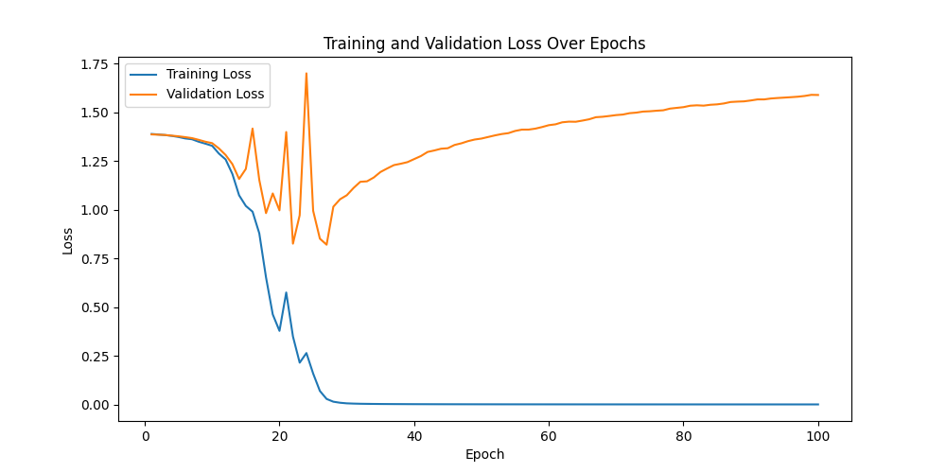
Training & evaluation

Slide 10
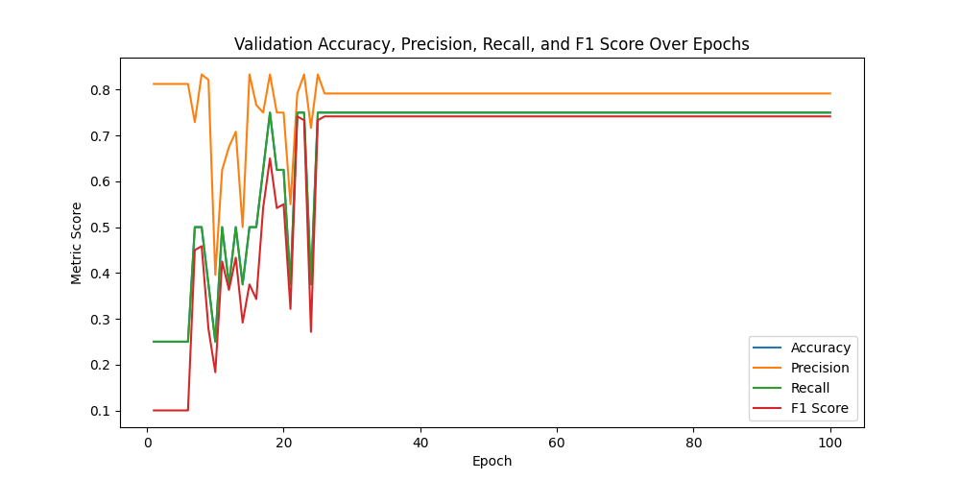
Training & evaluation

Slide 11
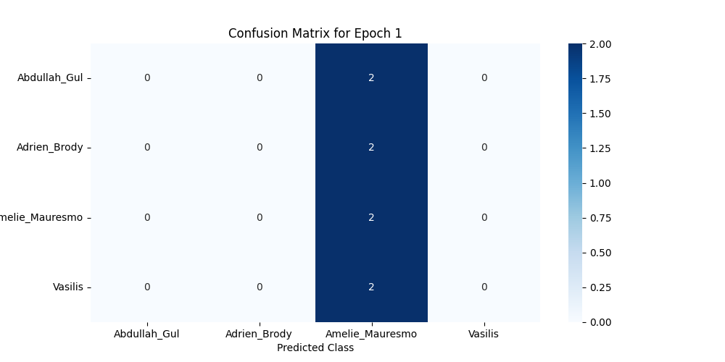
Training & evaluation

Slide 12
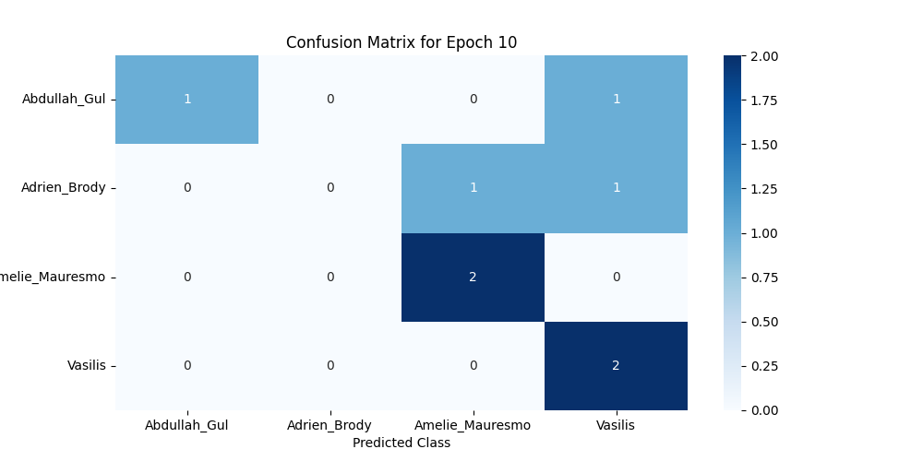
Training & evaluation

Slide 13
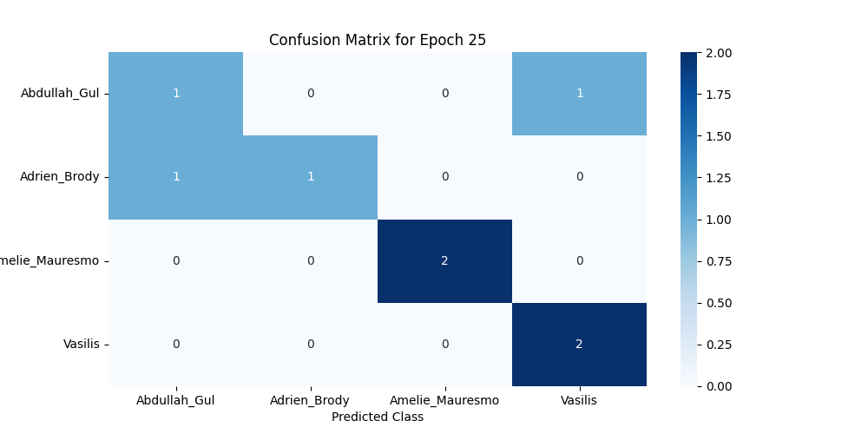
Training & evaluation

Slide 14
Real time inference
Face Detection: Identify faces from a real-time video stream. This is the first step in recognizing a person from a video.
Pre-processing: After detection, faces are pre-processed (resized, normalized) to be input into our trained model
Model Inference: We feed the pre-processed faces into our trained model, which outputs a class label corresponding to the person recognized.
Multiple Models: The system’s capable of loading one of the trained models to perform the classification.
Output Presentation: Displaying a highlighted area with the name of the recognized person on the video feed.

Slide 15
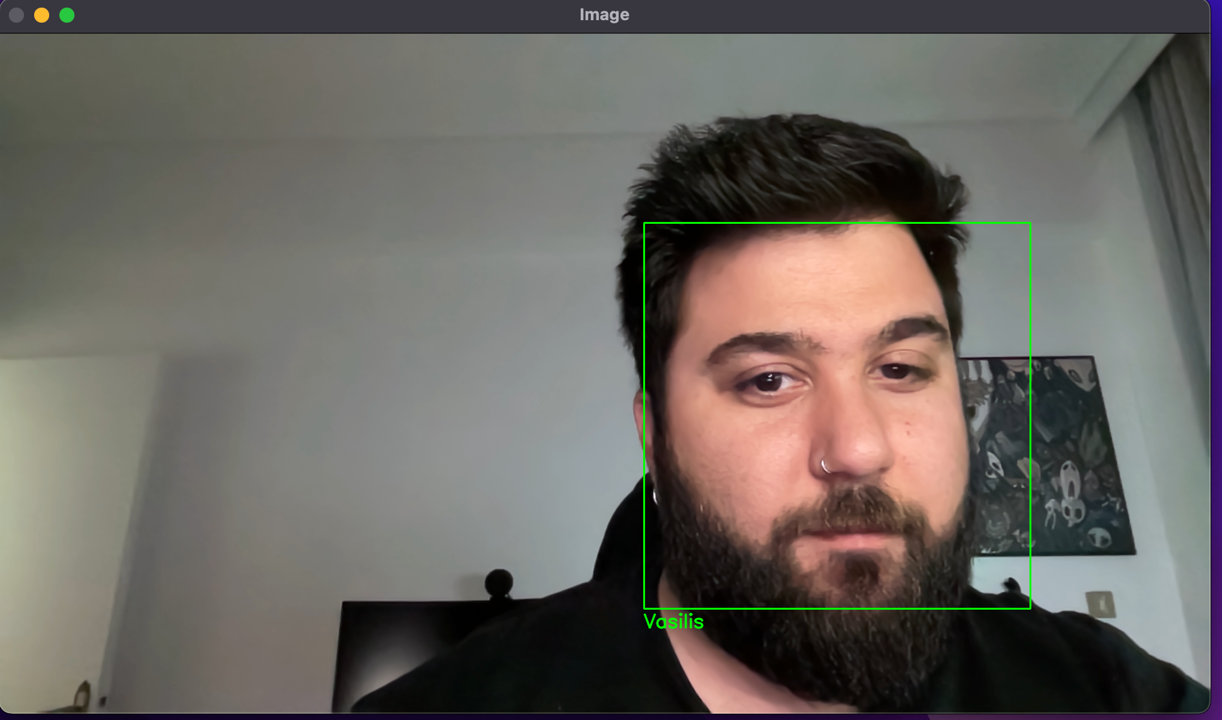
Real time inference

Slide 16
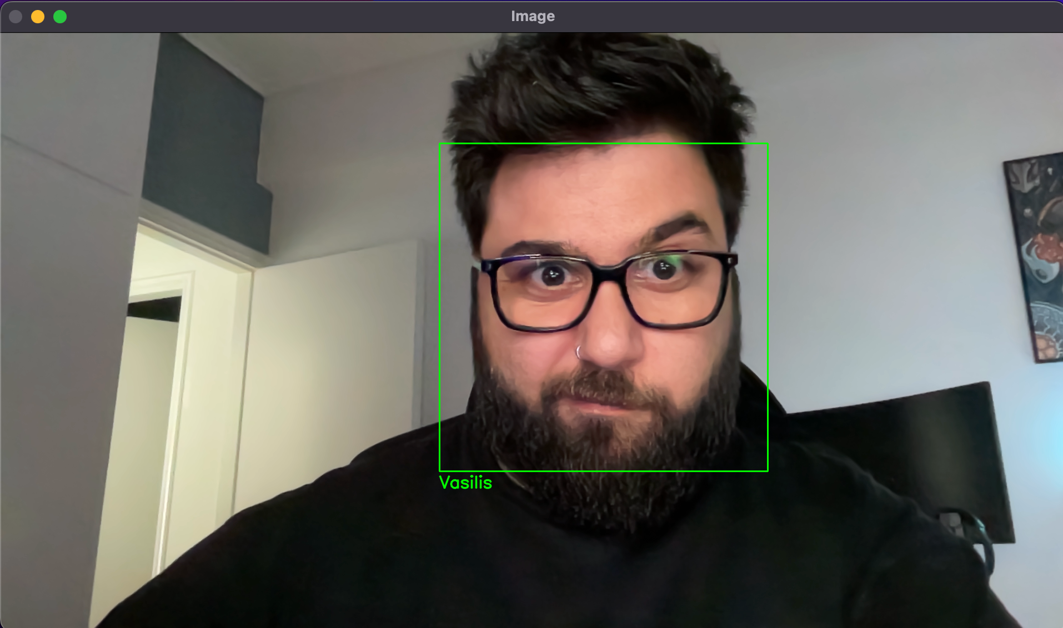
Real time inference

Slide 17
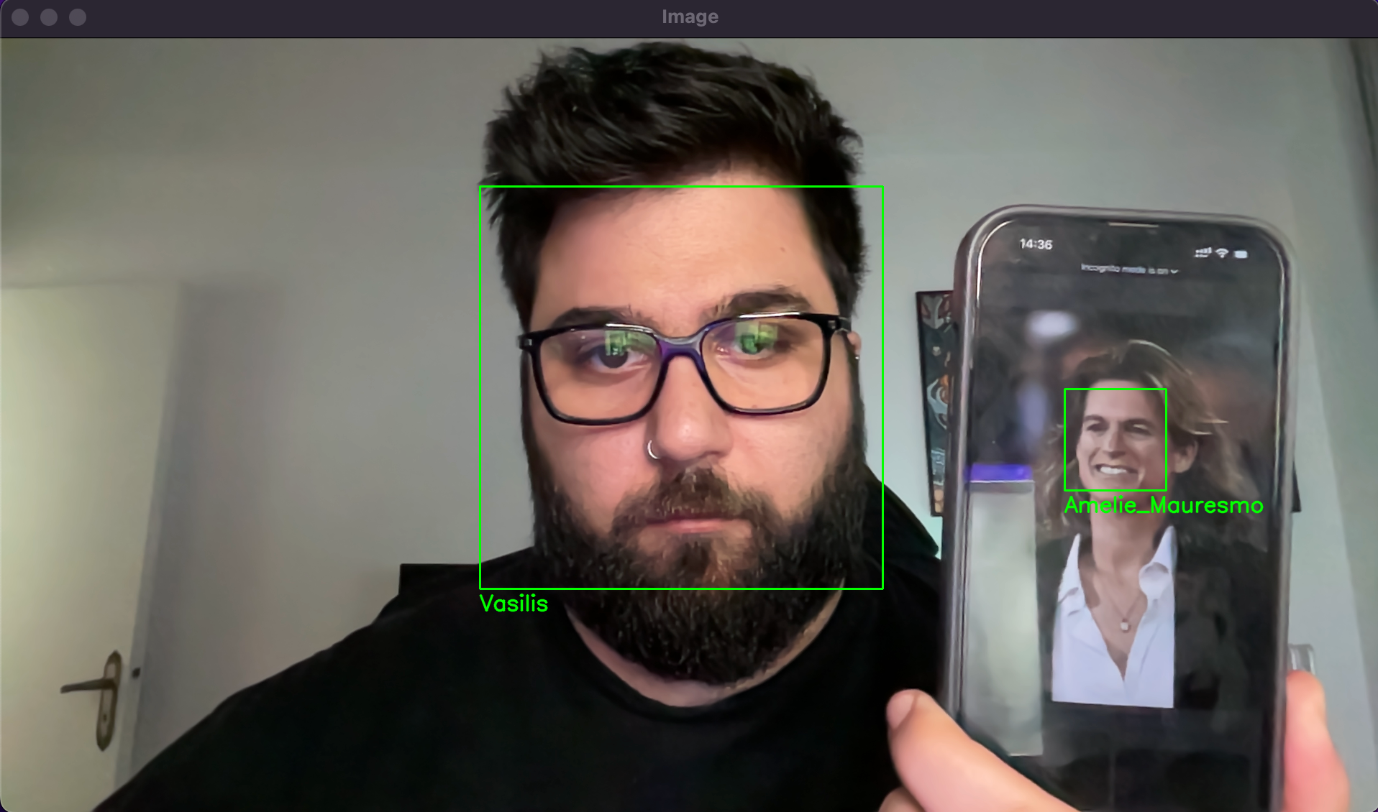
Real time inference

Slide 18
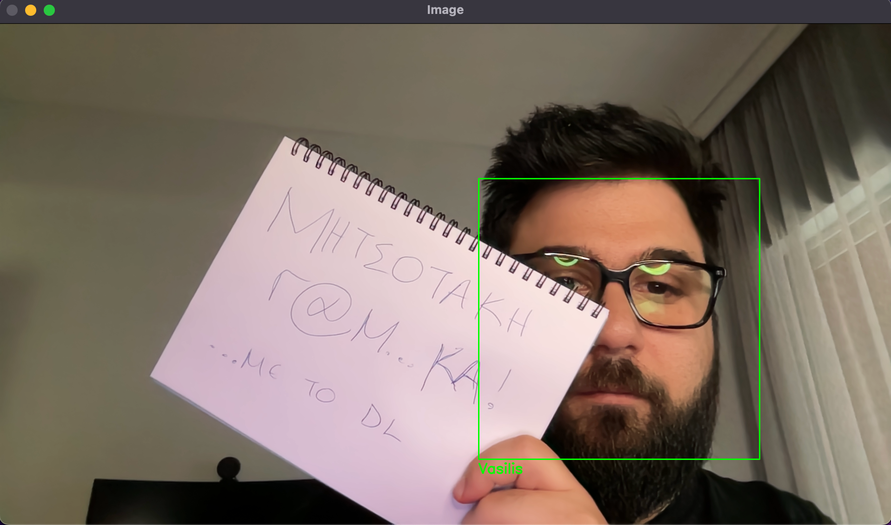
Real time inference

Slide 19
Difficulties & obstacles
Data Quality and Diversity: Quality and diversity of the data to avoid bias in the model.
Hyperparameter Tuning: Choosing the right set of hyperparameters for the model was a trial-and-error process.
Real-Time Performance: Optimizing the model for real-time inference required efficient image processing and model prediction techniques to maintain a smooth and responsive user experience.
Model Interpretability: Understanding why the model made certain predictions was nontrivial. Understanding individual mistakes was more complex.

Slide 20
Difficulties & obstacles
Hardware Performance: Though a capable machine was used, one can identify how time consuming is the training process even on a small dataset of static data.
Hardware Compatibility: Using new M2 silicon was an issue as PyTorch has still some flaws regarding “arm64” kernel architectures.
Testing: To test the functionality of the application it was necessary to search for a matching dataset in addition to the one produced by the camera feature.

Slide 21
Conclusion & future work
Design and implementation of CNN architecture.
Training and evaluating the model using our custom dataset.
Real-time face recognition capabilities.

Slide 22
Conclusion & future work
Improve Data Diversity: Aim to enrich the dataset by including more diverse face images to improve the model's ability to recognize a wider range of faces.
Model Optimization: Fine-tune the model further to improve its accuracy, precision, etc.
Enhanced Robustness: Improve the robustness of the system to handle a wider variety of real-world scenarios such as different lighting conditions, orientations or identify expressions, emotions etc.

Slide 23
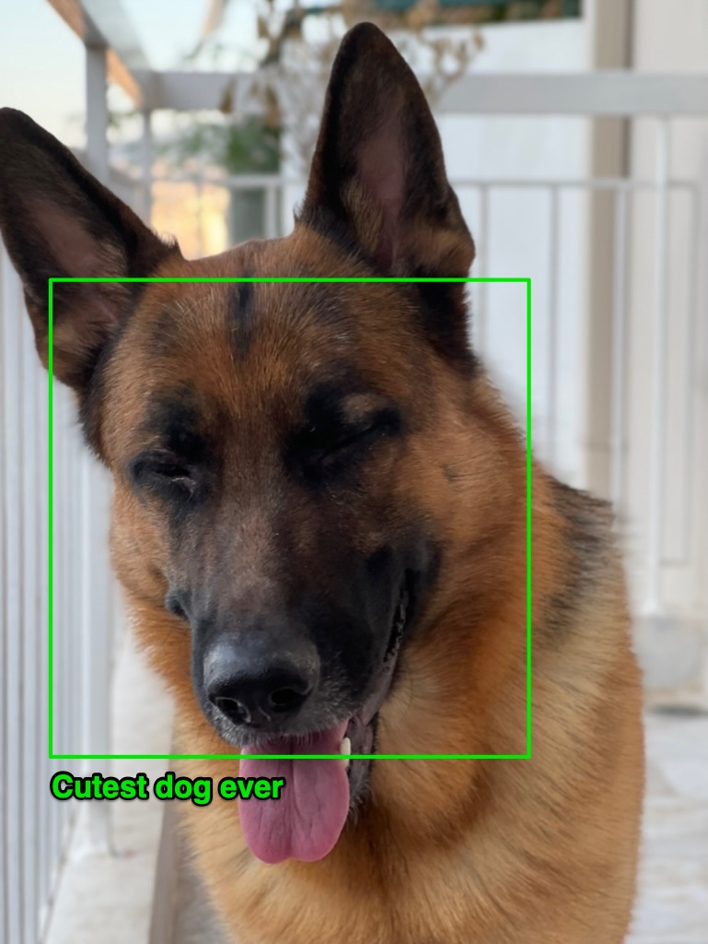
Questions & discussion
Please be gentle…!

Slide 24
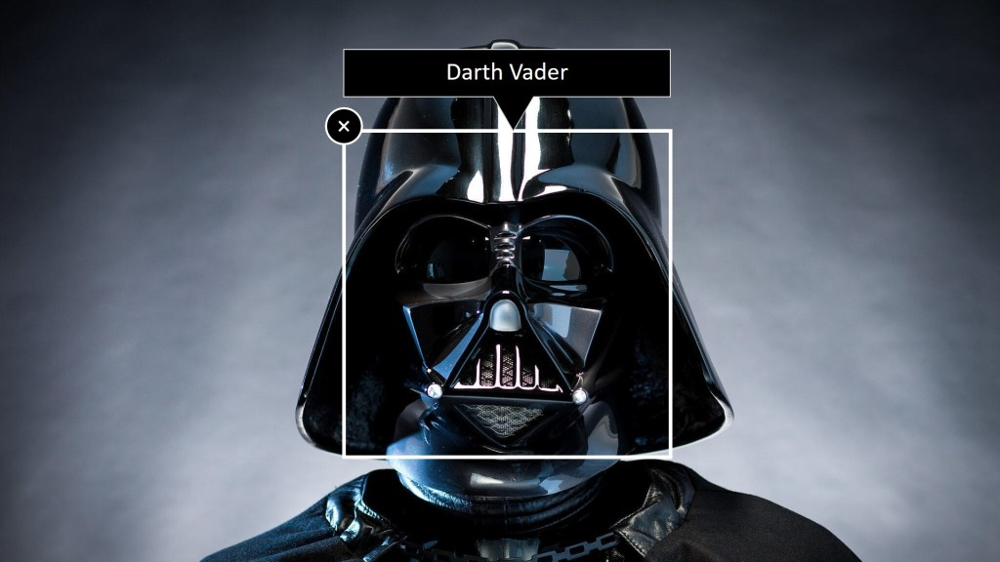
Thank you!!!
Darth Learning
I am your FATHER!!!
This Photo by Unknown Author is licensed under CC BY

